Slide 1
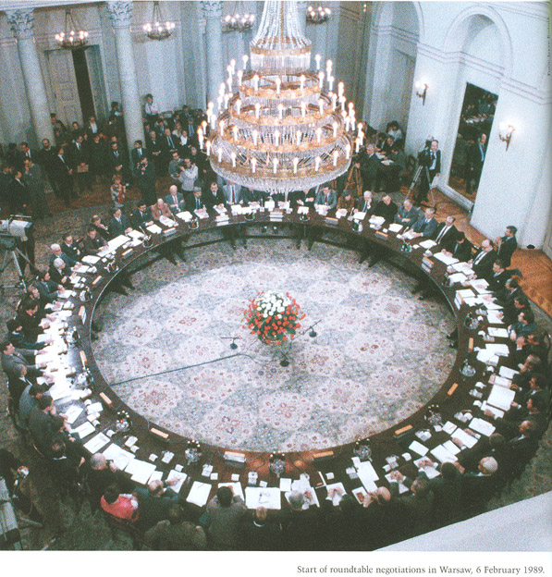

HISTORIANS’ ROUNDTABLE
SEPTEMBER 22, 2012

Slide 2
AGENDA
Brief Introduction of attendees
2 Distribution of updated Directory of Burlington County Historical Societies, History Organizations, and History Resources - including personal contacts, addresses, phone numbers and e-mail addresses.
3. Special presentation on Historical Markers and Wayfinding Signs in Burlington County -- focusing on exemplars, vendors, costs, hints on style and trends. Joe Laufer has compiled data from a variety of resources to share with us. Illustrated presentation.
4. "Who's Speaking Where?" - Overview of history programs throughout the county during the last quarter of 2012. Includes resources for speakers for your organization.
5. VIP pre-public preview of the new library facilities, including the new 250 seat theater/auditorium.
6. Update on in-service project for county teachers focusing on Burlington County History and local Historical resources.

Slide 3
7. Last minute details about "Hobnobbing with Historians" -- our own history tent at Arts in the Park at Smithville on Sunday, September 23 - the day after the Roundtable. If you have not signed up to promote your organization at this event, please do so by submitting the registration form NOW.
8. Immediately after the Roundtable, we are invited to Lumberton for a walking tour of the village by long-time Lumberton historian and author, Weldon Storey. In order to accommodate members of the Roundtable, they re-scheduled the tour for 1:00 p.m. It is a rare opportunity to learn about this historic Burlington County village. The town is holding a day-long event called "Lumberton Paddle"
9. In case you hadn't heard, The County Freeholders and Colonial Dames are sponsoring a tour of One-Room School Houses on November 17. More about that at the Roundtable, but meanwhile, you might find it interesting to visit their new Facebook page: www.http://www.facebook.com/historicburlschoolhouses
10. Debriefing on 2012 "History Faire at the County Fair" - and plans for 2013

Slide 4

Immediately after the Roundtable, we are invited to Lumberton for a walking tour of the village by long-time Lumberton historian and author, Weldon Storey. In order to accommodate members of the Roundtable, they re-scheduled the tour for 1:00 p.m. It is a rare opportunity to learn about this historic Burlington County village. The town is holding a day-long event called "Lumberton Paddle"

Slide 5

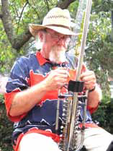
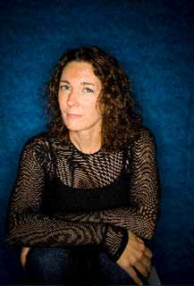
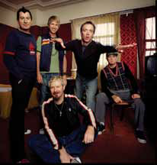
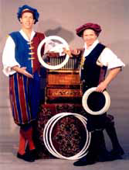
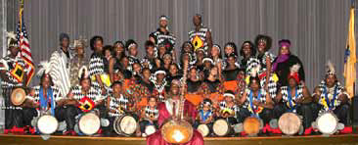
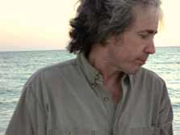
Arts in the Park Festival Returns Sept. 23
Sunday, 10:30 a.m. until 4:00 p.m.
Historic Smithville Park, Eastampton

Slide 6


2. Self introductions and brief announcements of "What's happening in your neck of the woods?"

Slide 7
ALICE PAUL INSTITUTE
Thursday, September 27 at 7:00 p.m.
Alice Paul Institute, 128 Hooton Road, Mt. Laurel
“Born in the USA: Birth, Commemoration, and American Public Memory”
A book and author talk with Seth Bruggeman, assistant professor of history and public history coordinator at Temple University, who edited this collection of essays on how and why we choose what we commemorate and the challenges of managing historical sites. Paulsdale, the birthplace of Alice Paul and the Alice Paul Institute’s headquarters, is the subject of one chapter in the book. Founding members of the Alice Paul Institute will discuss their experiences in saving and restoring Paulsdale.
For more information, www.alicepaul.org.
Reserve your space by email at info@alicepaul.org or by calling 856-231-1885.

Slide 8

John Woolman Memorial Association Presents the 65th Annual Woolman Lecture Geoffrey Plank will speak on "THE OTHER WOOLMANS: FAMILY LIFE AND THE IDEALS OF AN 18TH CENTURY ABOLITIONIST" Discussion and reception follow the lecture. Saturday, October 6, 2012 2 PM – 4 PM At Mount Holly Friends Meeting 81 High Street Mount Holly, NJ For Map & Directions visit: http://goo.gl/maps/mbCHk For further information call (609) 267-3226
Geoffrey Plank is a
Professor of American Studies
at the
University of East Anglia , England.
His lecture is based on his recently published book,
" John Woolman’s Path to the Peaceable
Kingdom:
A Quaker in the British Empire."

Slide 9
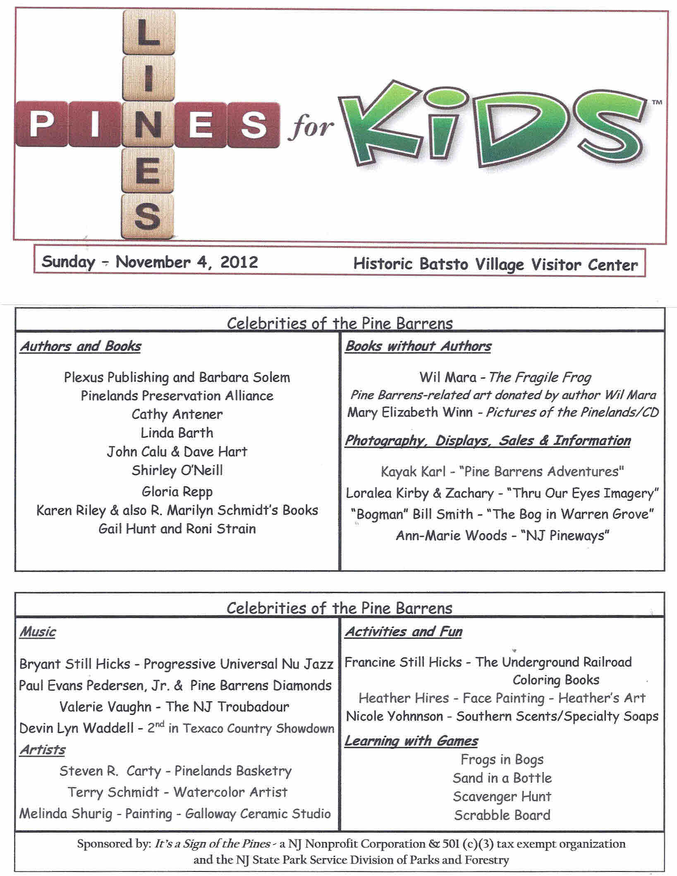
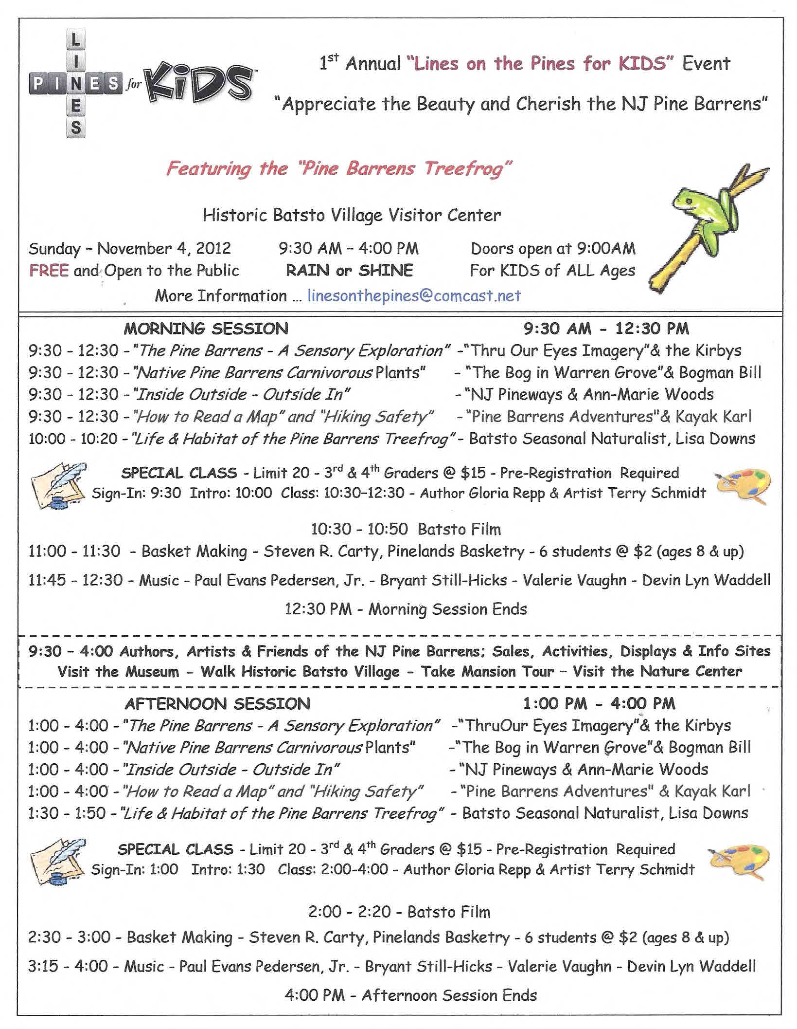
November 4, 2012
Historic Batsto Village

Slide 10
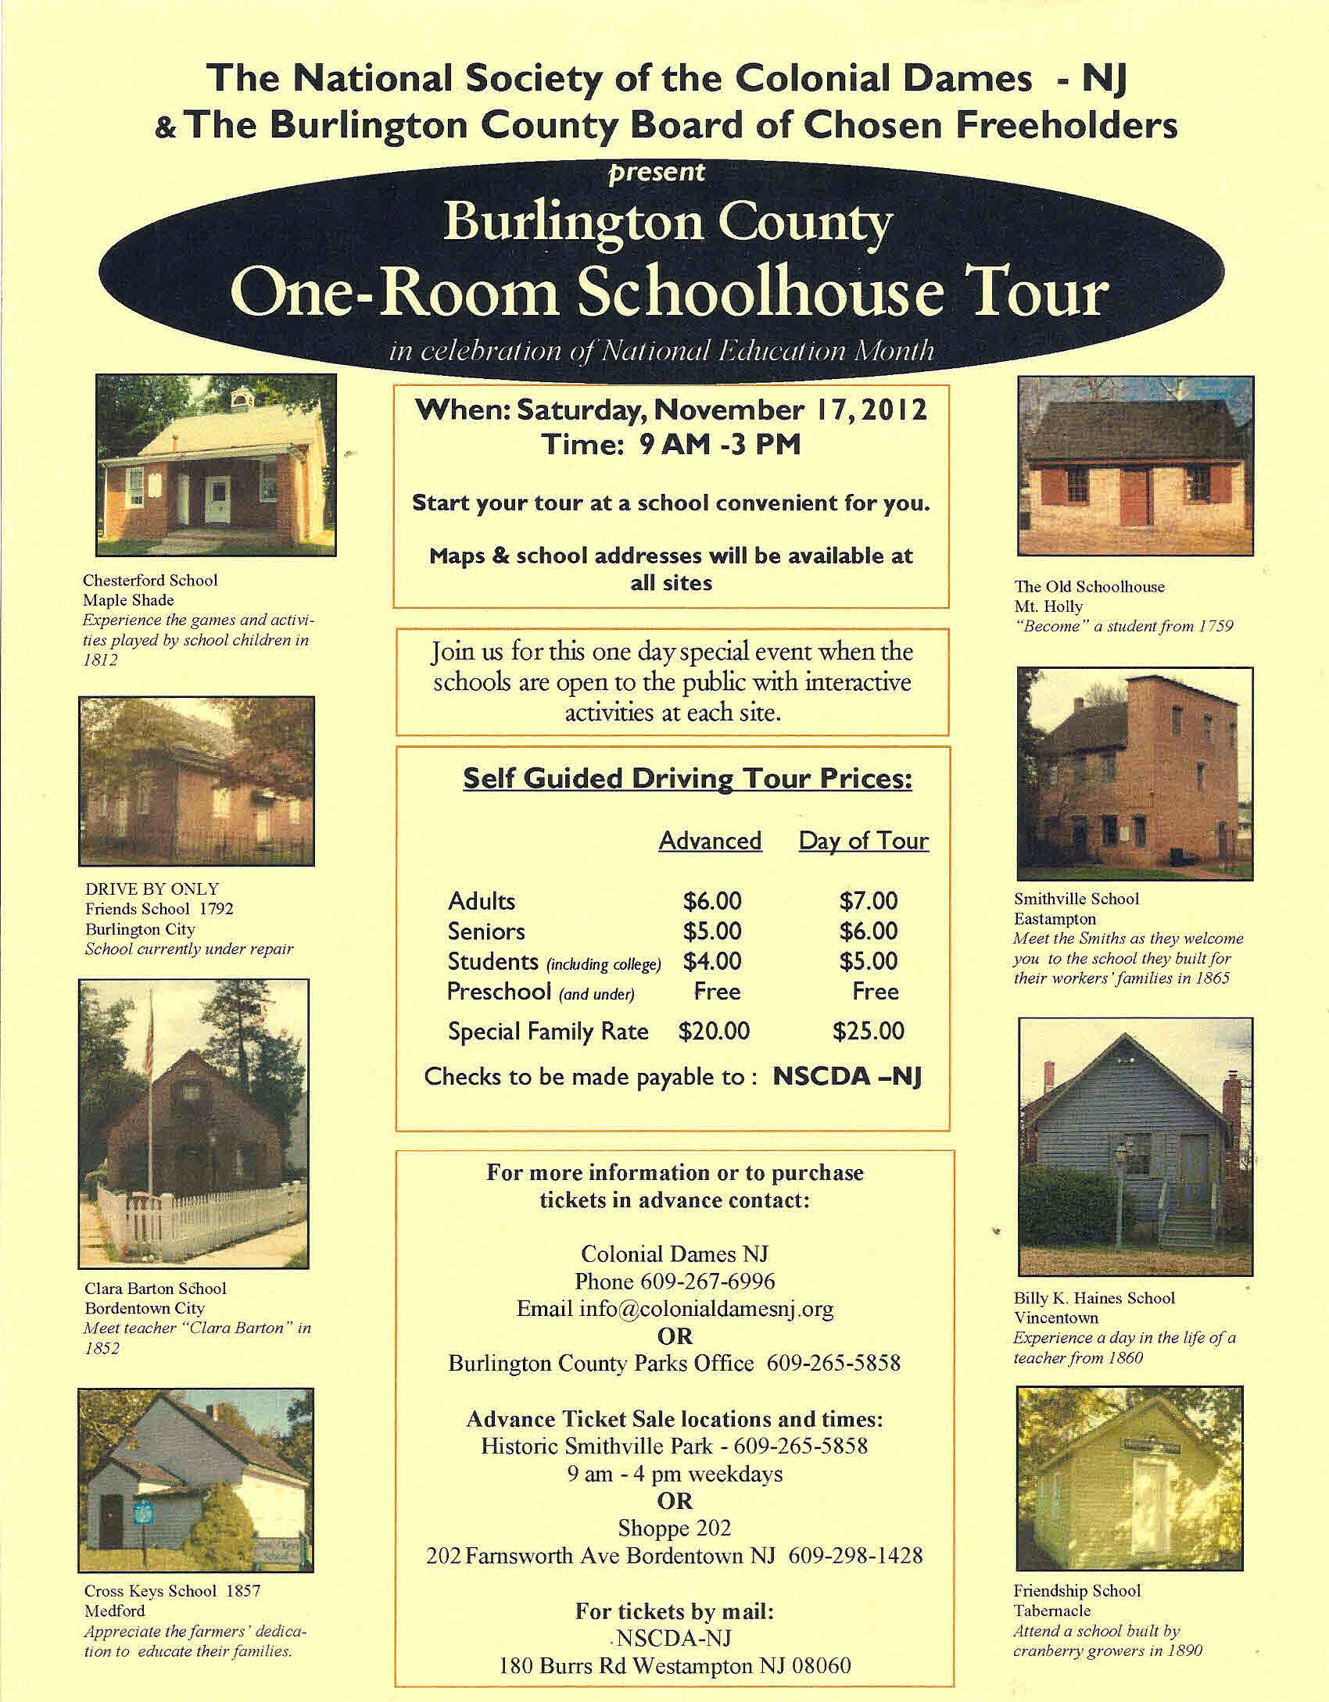
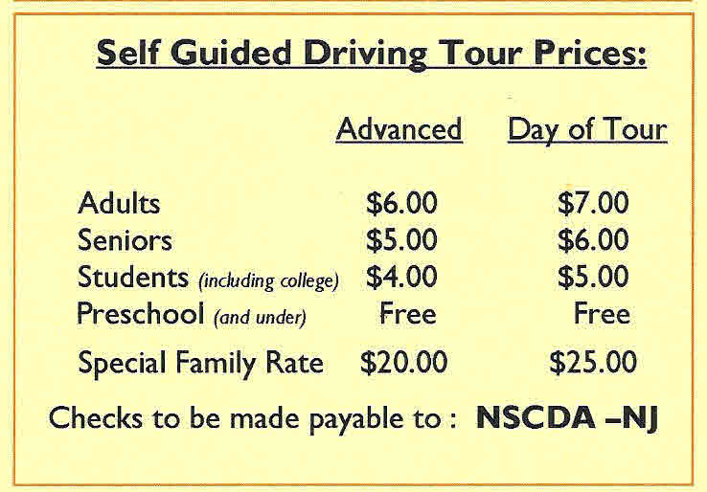
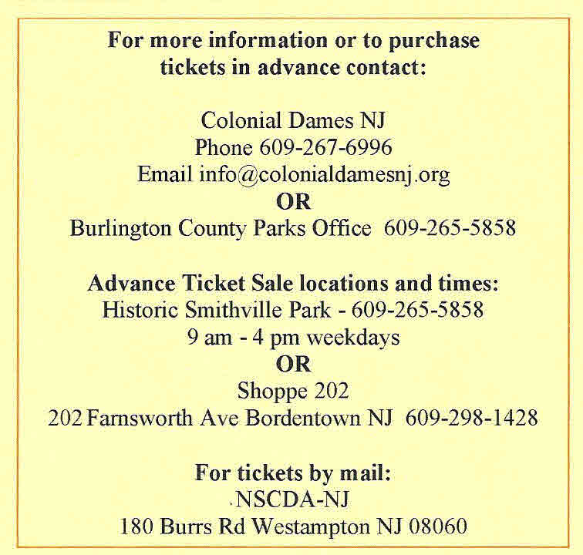

Slide 11
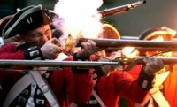
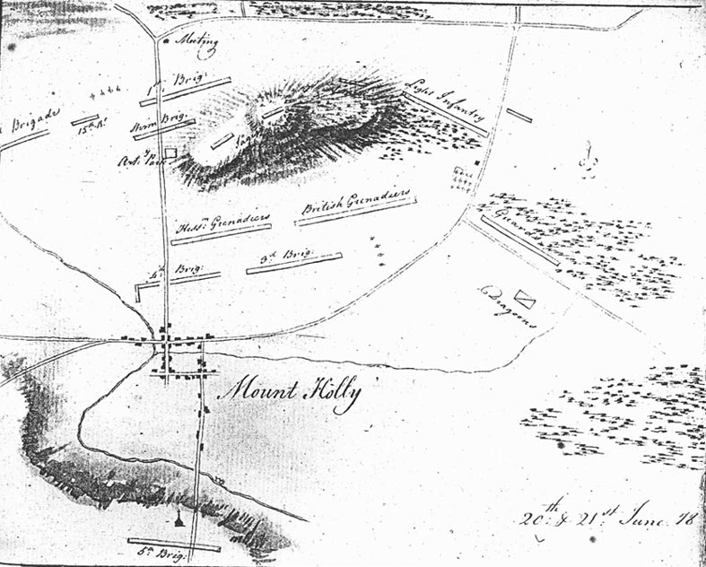
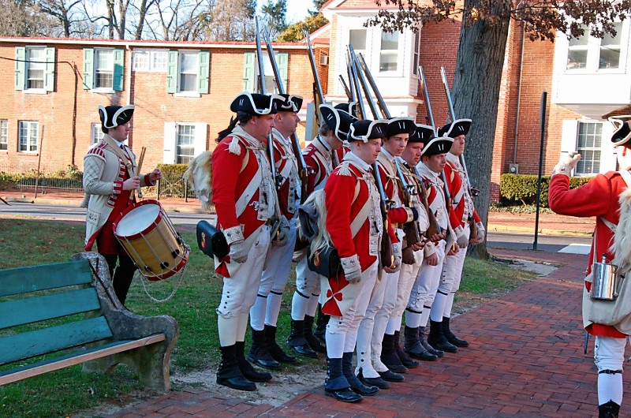
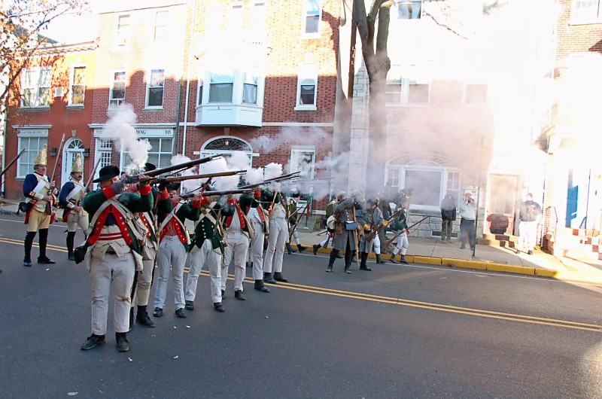
Battle of Iron Works Hill Re-enactment
Saturday, December 8 – Mt. Holly
http://www.ironworkshill.org/

Slide 12
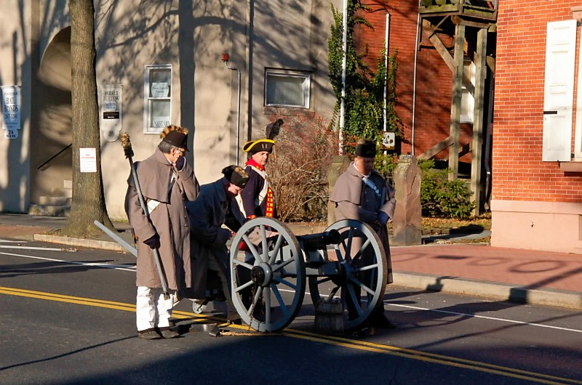
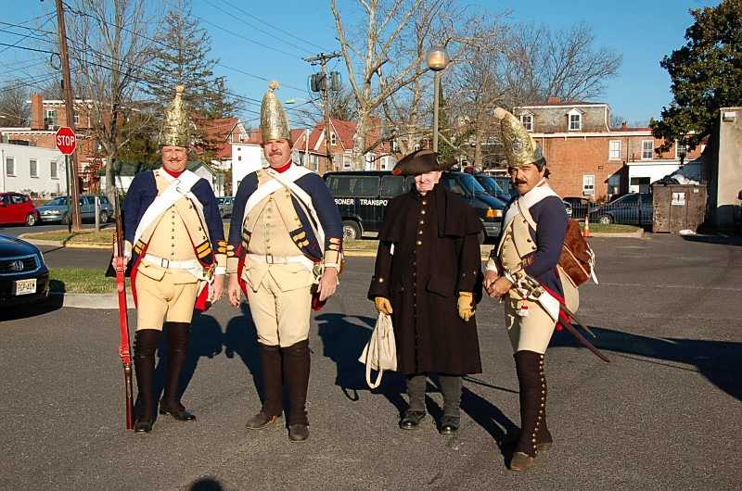
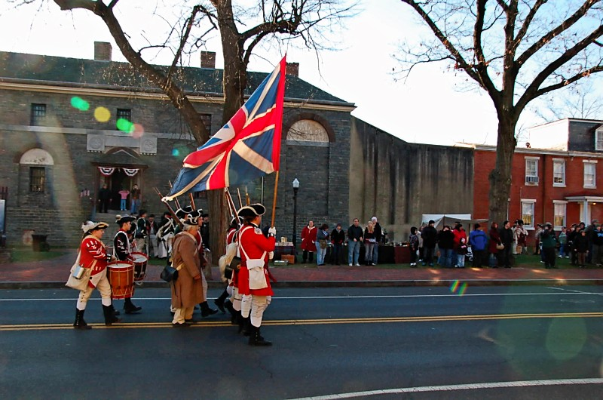
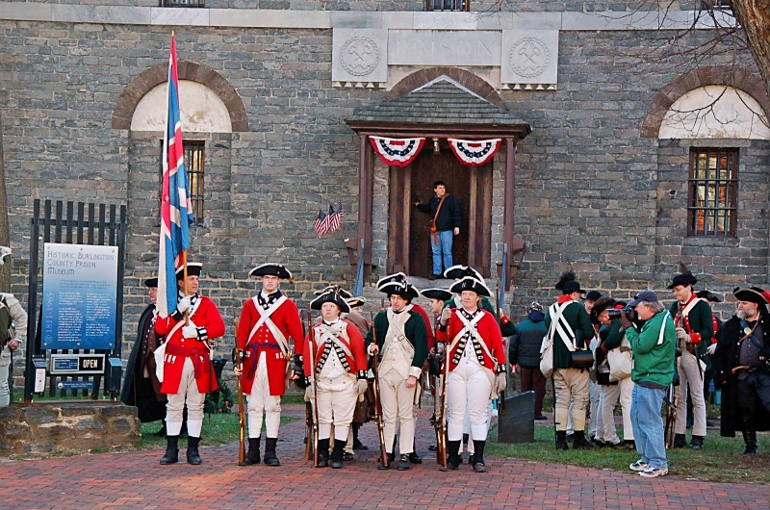

Slide 13

Update: Bob Von Bargen

Slide 14
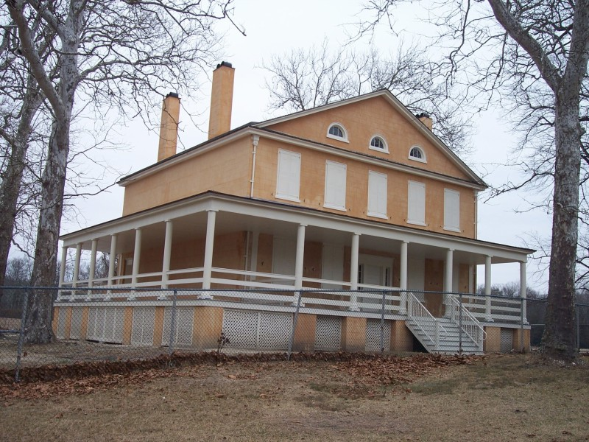
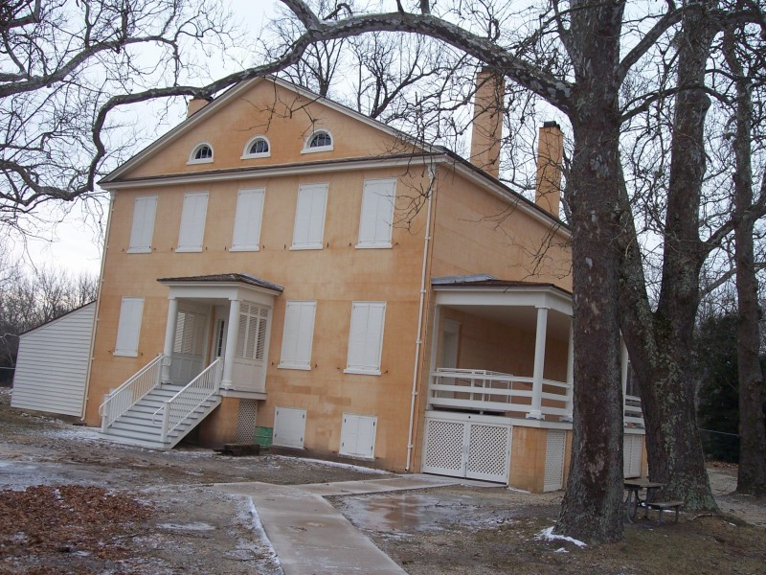
Update: Barbara Solem Stull
Atsion Mansion

Slide 15
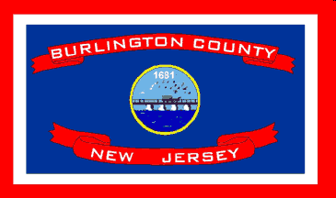
Bridge to our Past
1694-2012
318 Years as Burlington County
Joseph M. Laufer, Burlington County Historian

Slide 16
BRIDGE TO BURLCO’S PAST 318 YRS.
I. Origins
II. Military Matters
III. Religion
IV. Education
V. Natural Resources/Industry
VI. Transportation
VII. People & Personalities

Slide 17
Passport to History
in your Backyard!
21 Historic places to visit in Burlington County
Presented by Joseph M. Laufer,
Burlington County Historian

Slide 18
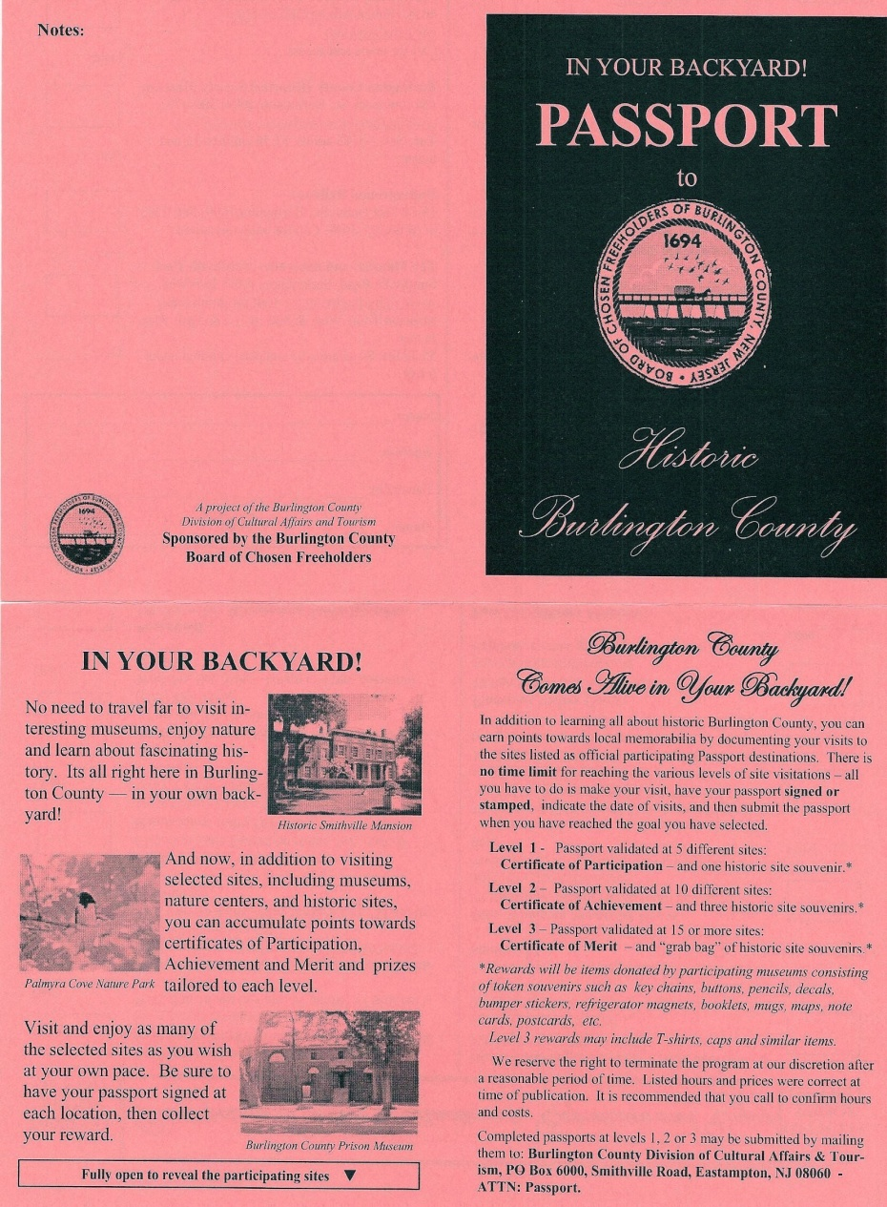
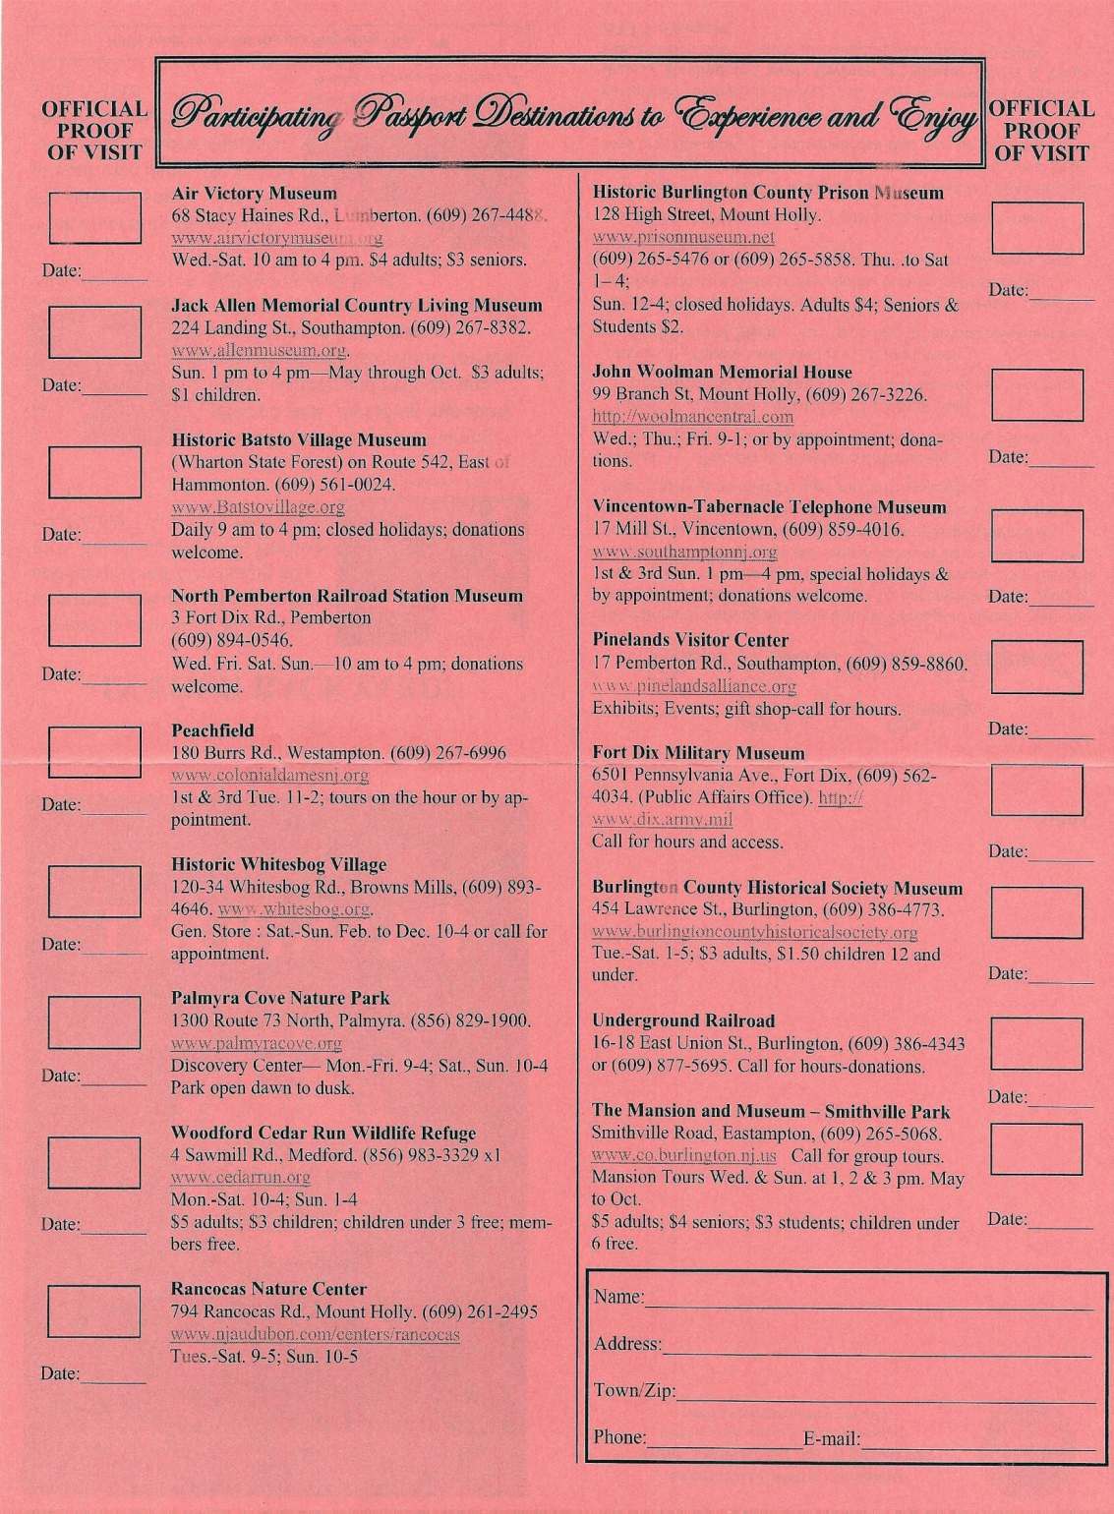

Slide 19
BURLINGTON COUNTY HISTORICAL SOCIETY
SUNDAY LECTURE SERIES 2011-2012 AT THE CORSON POLEY CENTER
Behind 457 High Street, Burlington - 2-4 PM - Q & A Period and Refreshments follow.
Program Chairperson: Judy Olsen
Email: burlcohistsoc@verizon.net
October 28: Dr. Richard Veit: Co-author of Stranger Stop and Cast an Eye. Dr. Veit will explore the cultural history of New Jersey's historic cemeteries and burial grounds from the 17th century through the dawn of the 21st century. His presentation will provide an understanding of the state's historic burial places and the grave markers they contain.
November 18: Carl Jablonski: Director of the Navy Lakehurst Historical Society> He will talk about the Hindenburg disaster in Lakehurst, NJ, on MAy 6, 1937. He will also have a display of Hindenburg artifacts.
December 7: This one is not a Sunday: It's in honor of the anniversary of Pearl Harbor. We are intending to have a brunch honoring our veterans followed by:
Charlie Breingan, World War II veteran and Flying Tiger, speaking on the history of the 1st American Volunteer Group (AVG) of teh Chinese Air Force in 1941-1942, famously nicknamed the Flying Tigers.

Slide 20
FAMILY EVENTS AT THE BURLINGTON COUNTY HISTORICAL SOCIETY
All are on Saturdays from 2-4 except the first one
October 13: 2-4
Pumpkin-palooza
A harvest festival with pumpkin painting, games and more
October 27: 2-4
Ghostly Tales: Storyteller Dennis Strain will make you laugh and shiver with his ghost stories form New Jersey! Crafts, snacks, and more!
November 3: 2-4
Pineland Pals! Enjoy snacks, crafts, and children's stories from the Pinelands with Roni Strain, author of "A Tree Frog in the Cranberry Bog," and more!
November 17: 2-4
Celebrate Thanksgiving with Native American games and crafts! Explore the differences between the Wampanoag at the first Thanksgiving to New Jersey's Lenni Lenape culture.
December 7: (Friday) See above for Charlie Breingan event
December 15: 2-4
Winter Festival: Vote for your favorite entry at our Gingerbread House contest. Holiday crafts, snacks, and more!

Slide 21
SOUTHAMPTON HISTORICAL SOCIETY – 2011-2012 -2013
FIRST MONDAY MEETINGS – OLDE TOWN HALL, 25 PLUM ST.7:30 PM
Program Chairman: Joe Laufer
Email: info@BurlcoHistorian.com
October 1 : Larry Tigar: Mount Holly - Then and Now - In Pictures
November 5: Stacy Flora Roth: Soldiers Without Guns: Women Defense Workers of WW II
December 3: Ian Johns: The Battle of Iron Works Hill: Burlington County's Contribution to Washington's Victory at Trenton in 1776.
2013
March 4 : Barbara Solem-Stull: Ghost Towns & Other Quirky Places in the New Jersey Pine Barrens
April 1 : Betsy Carpenter: Elias Wright: Teacher, Military Leader, Surveyor Extraordinaire.
May 6: Clifford W. Zink, Author: "The Roebling Legacy"
June 3 : (no speaker): Strawberries, Stories and Surprises

Slide 22
MEDFORD HISTORICAL SOCIETY - 2012
First Thursday - Medford Friends Meeting House,
14 Union St., Medford
Program Chairperson: Janet Jackson Gould: 609-654-6485 - jsjacksongould@comcast.net
October 4: "Medford" - presented by Dennis McDonald (Author of Arcadia Photo book on Medford)
November 1: Scandals, Rumors & Dirty Rotten Lies, by Dorothy Stanaitis
December 6: Songs of the Season, by Charlie Zahm.

Slide 23


Wayfinding Signs and
Historical Markers
Burlington County
Exemplars and Resources

Slide 24
MEDFORD
More Historical Markers per capita than any other community in Burlington County
63 Historic Sites Markers
  35 sites within Medford Village
  28 sites outside Medford Village
A project of the Medford Historic Advisory Board celebrating the Sesquicentennial of Medford Township: 1847-1997

Slide 25
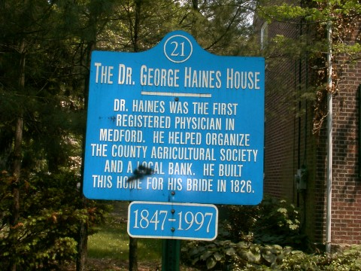
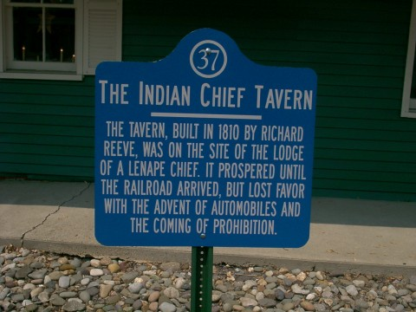
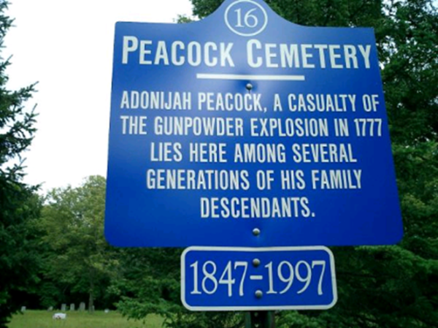
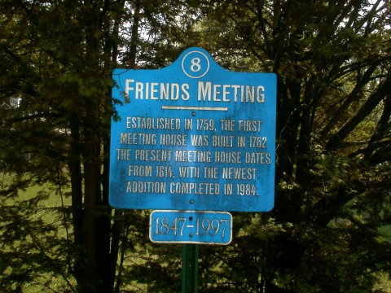
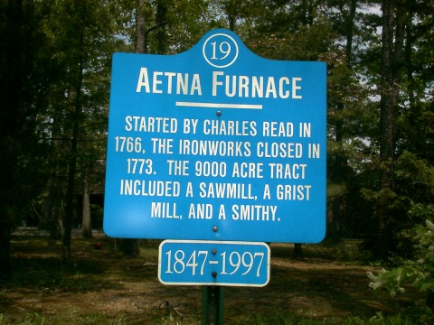
34 wds.
42 wds.
21 wds.
28 wds.
30” x 30”
Incl. bubble
26 wds.

Slide 26
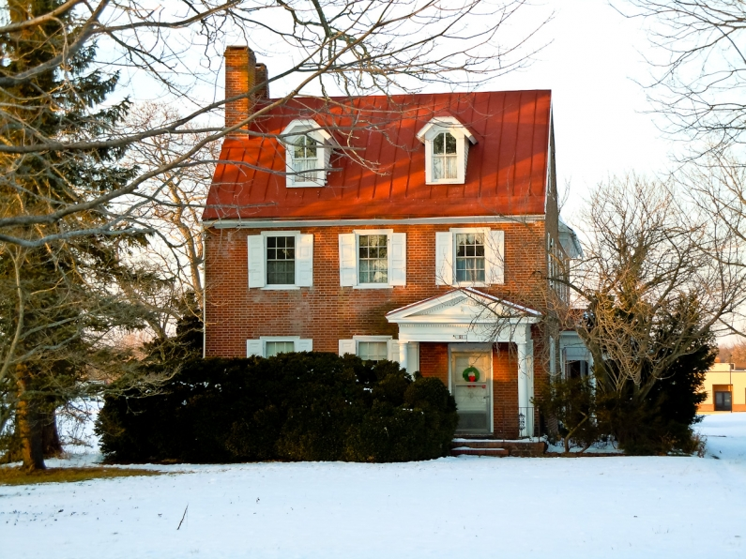
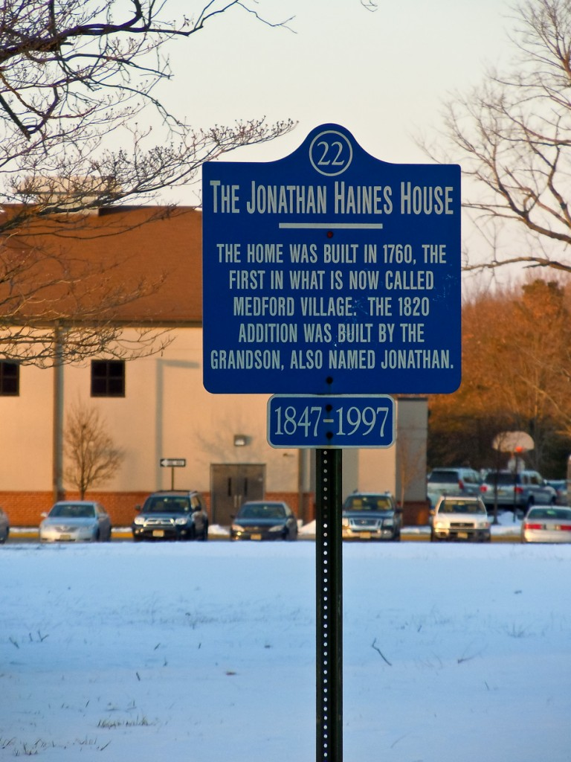
30 wds.
15 markers out of 63

Slide 27
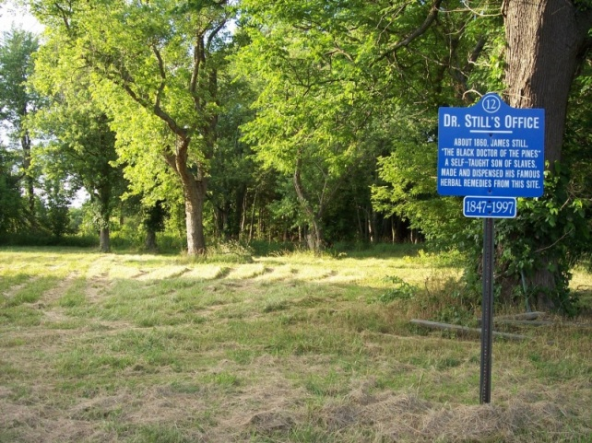
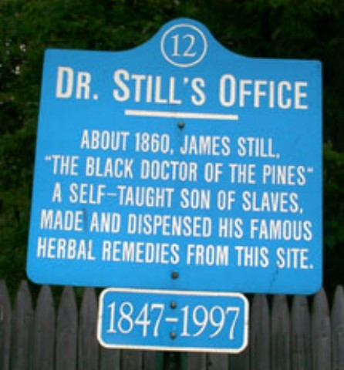
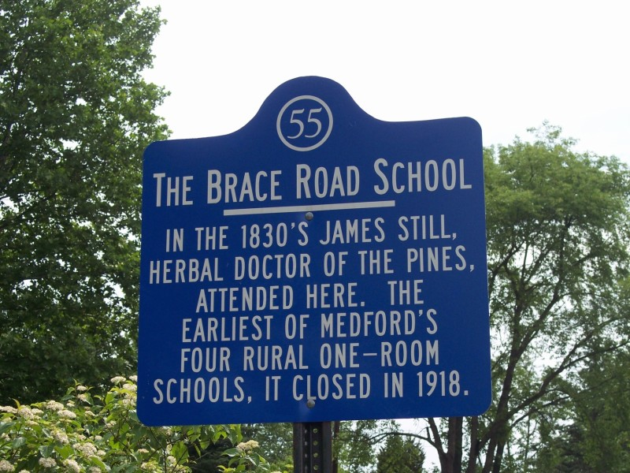
Booklet with the 63 site descriptions is reproduced on the internet
at
http:www.westjerseyhistory.org/books/medsites
A SELF-GUIDED TOUR
of
63 of Medford's Historic Sites
PREPARED BY
THE
MEDFORD HISTORIC
ADVISORY BOARD
The blue and white historic sites markers are,
in most instances, placed on private property.
The public is asked to respect the rights of the
owners and to regard the signs as information
and not as invitations to trespass.
2004
29 wds.
29 wds.

Slide 28
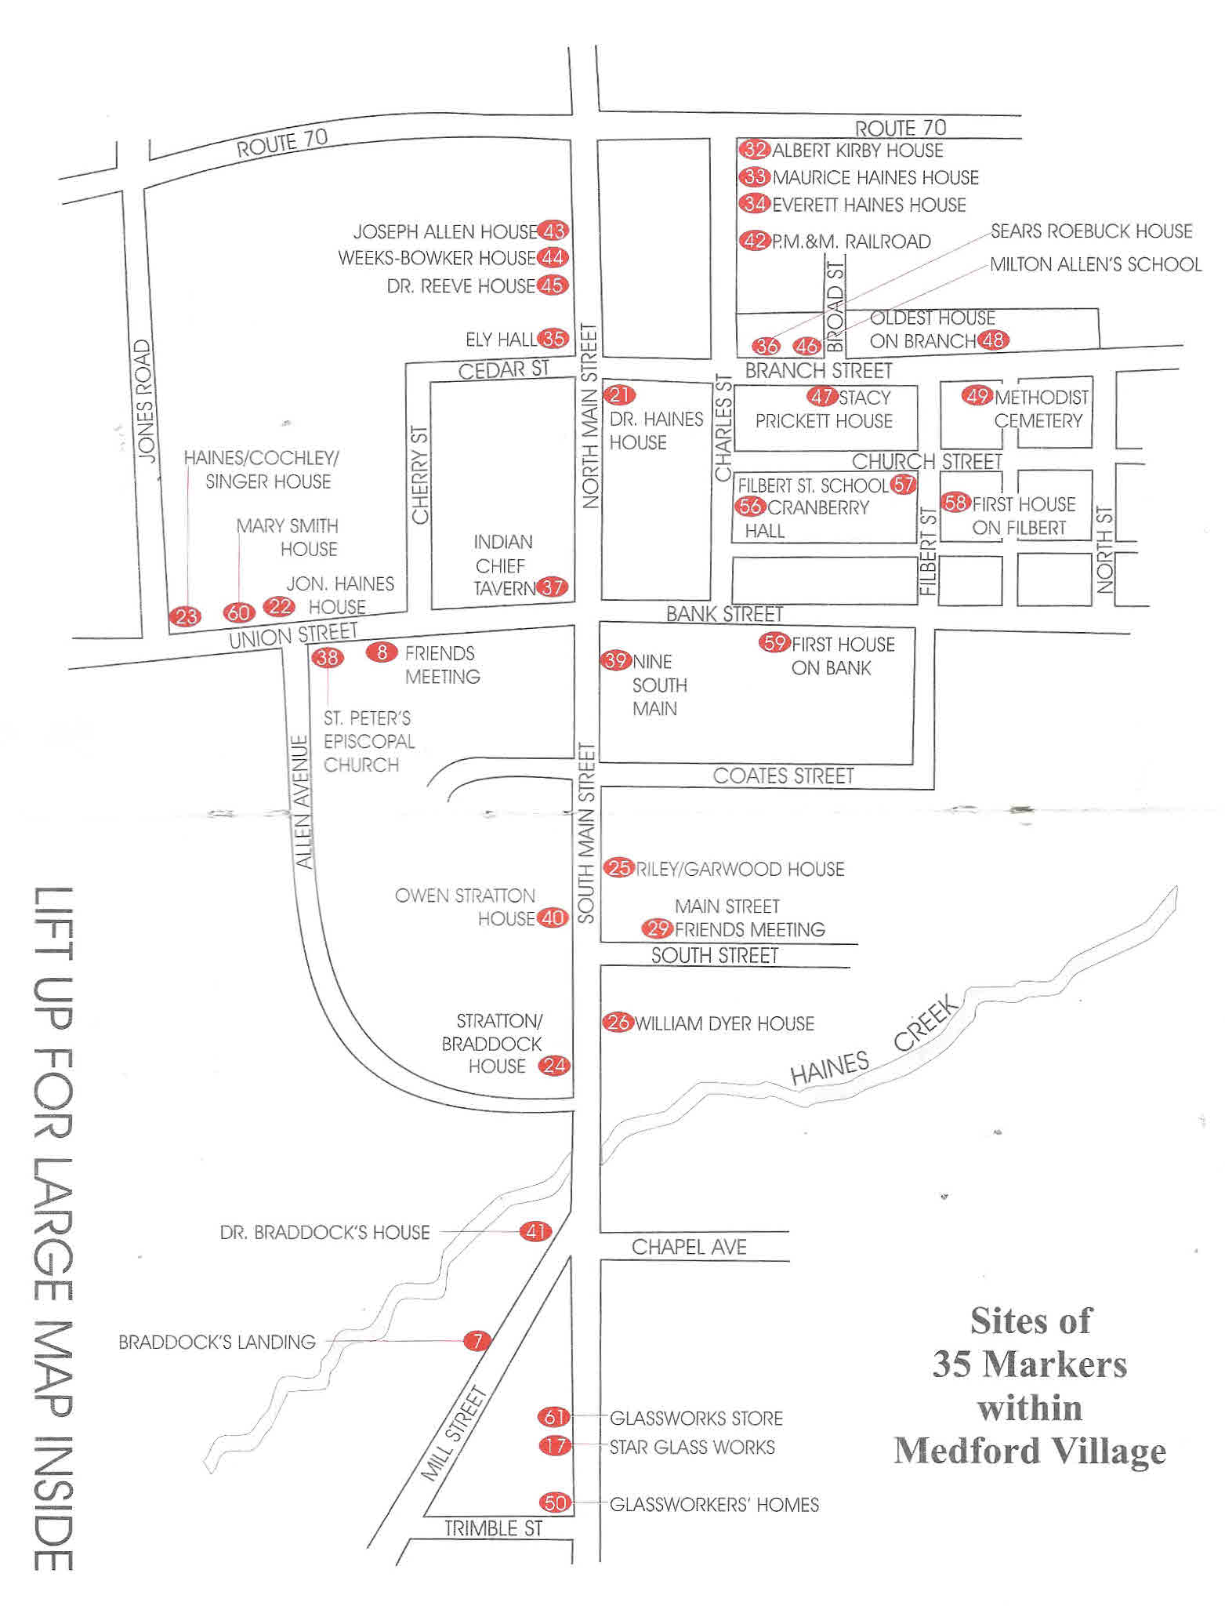
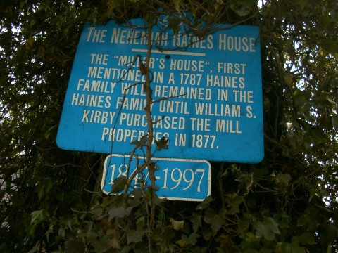
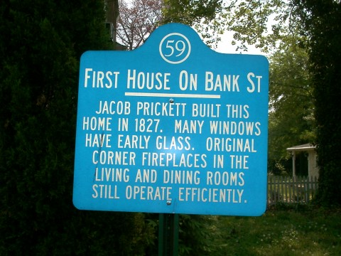
29 wds.
29 wds.
http:www.westjerseyhistory.org/books/medsites

Slide 29
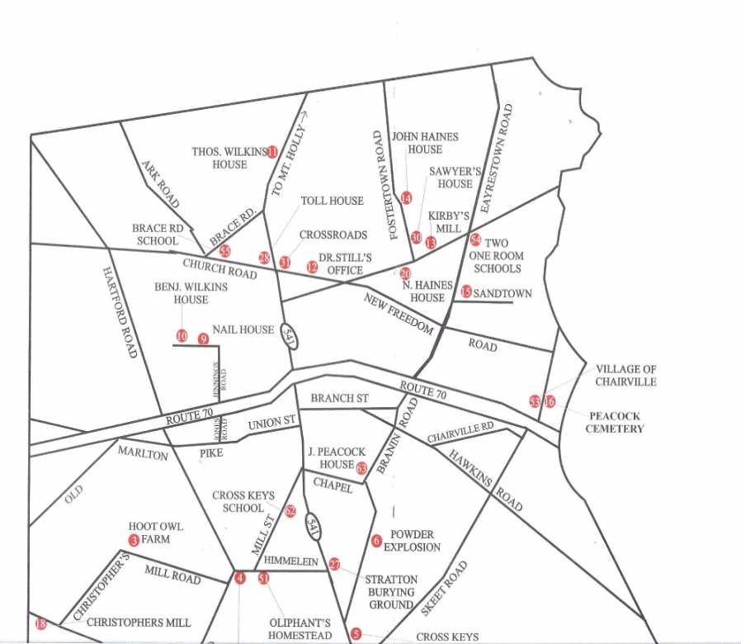
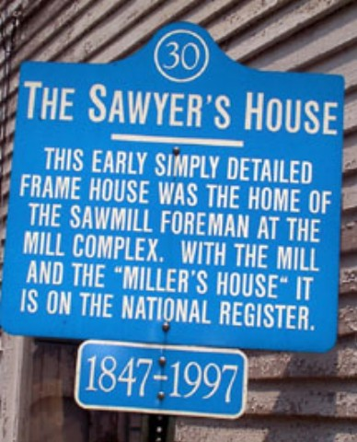
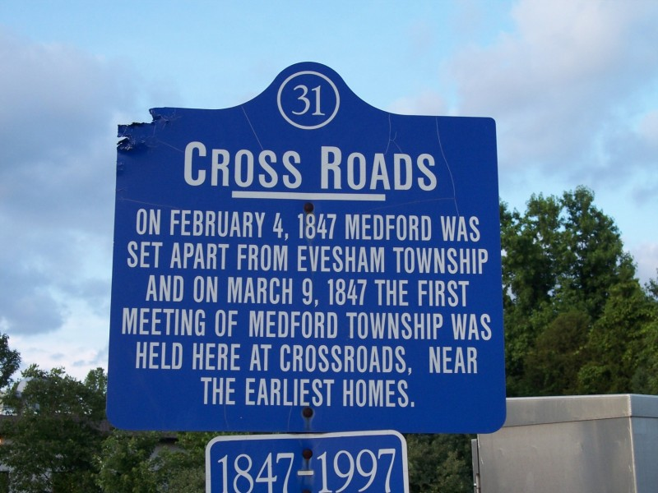
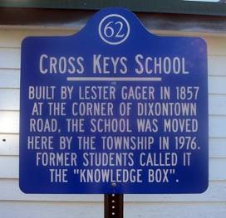
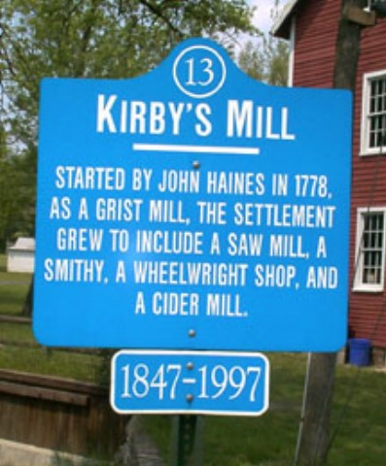
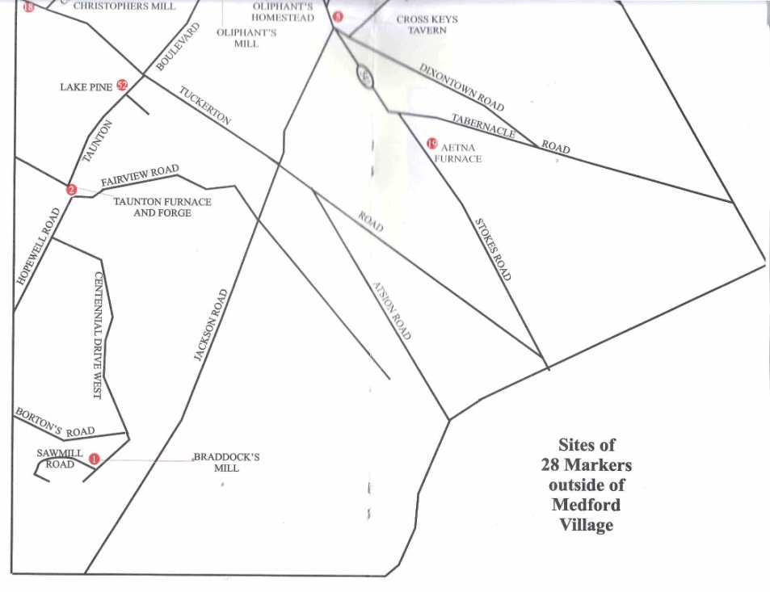
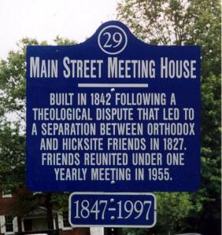
33 wds.
33 wds.
33 wds.
29 wds.
http:www.westjerseyhistory.org/books/medsites
31 wds.

Slide 30
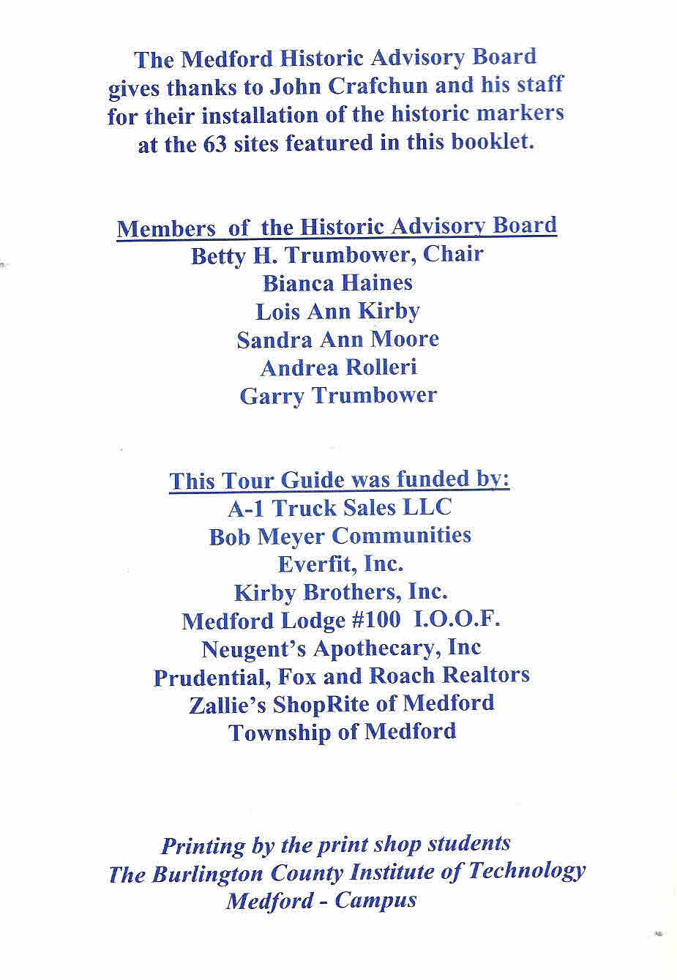
Contact:
Medford Historic Advisory Board
Betty Trumbauer, Chairperson - 609-654-7102
The signs were purchased through the NJ Department of Corrections: Deptcor.
Typical Cost for 2 color (Black on White; White on Black; White on Blue, etc.)
24” x 36” = $56.00
30” x 30” = $57.51
Additional cost for pole = $15
Contacts at DOC:
Sue Bencivengo - 609-633-8100 X 2437
Dibbie Tome - 609-633-8100 X 2434
The signs must be purchased through the local municipality, as Deptcor doesn’t work for individuals. State Contract # 49131

Slide 31


http://www.nj.gov/deptcor/index.html
609-633-8100 X 2437 - Sue Bencivengo
609-633-8100 X 2434 - Dibbie Tome
elizabeth.tome@doc.state.nj.us
CUSTOM SIGNS
In addition to the signs and materials shown here and stocked by DEPTCOR (including all of those meeting Federal Highway Administration specifications as set forth in the Federal Manual On Uniform Traffic Control Devices),
DEPTCOR can manufacture signs of any size, single color or color combination, in any design and quanity. State Contract # 49131
Example of these include regulatory signs for recreational locations (parks, beaches, etc.), parking lots, buildings and/or industrial districts, restricted areas, environmental warnings & guides, etc.
NOTE: Please call the DEPTCOR Sales Department, 1-800-321-6524, to obtain information and cost details

Slide 32
Special pricing for bulk purchases of same sign
Example: For a single message 12” x 18” wayfinding sign in multiples:
1 to 4 = $24.00 ea.
5 to 11 = $14.00 ea.
12 or more = $ 9.00 ea.
Alternate Private Sector Vendor: (Used by Tabernacle Historical Society)
Garden State Highway Products.
1740 E. Oak Rd., Vineland, NJ 08061
General phone # 856-692-7572
Frank Kates (sales) - cell phone: 609-381-2846
e-mail: Frank@GardenStateHwy.com.
Their prices seem somewhat comparable to Deptcor: -
24 x 30 plain rectangular $ 55.00. Special - $75 - $100 each.
post - green - $2.00 per ft. Galvanized $3.00 per ft.

Slide 33
TRADITIONAL
BRONZE AND IRON
HISTORICAL MARKERS
VARIOUS LOCATIONS

Slide 34
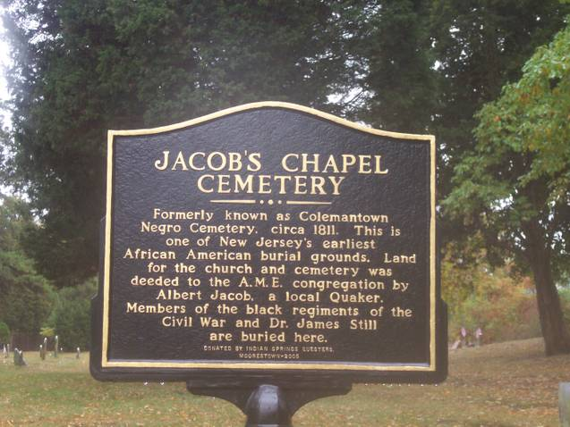
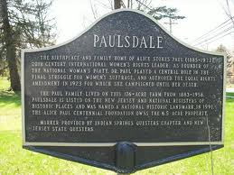
Top left sign was donated to Jacob’s Chapel by the Indian Springs Questers of Moorestown. They also donated a similar sign to the Alice Paul Foundation at Paulsdale, Mt. Laurel.
For an idea of the cost of this kind of sign, and where it can be purchased, you can contact Gail Payne, a member of Questers, and the person who coordinated the Jacob’s Chapel project.
856-235-2708
E-mail: dpayne4501@aol.com
56 wds.
105 wds.

Slide 35
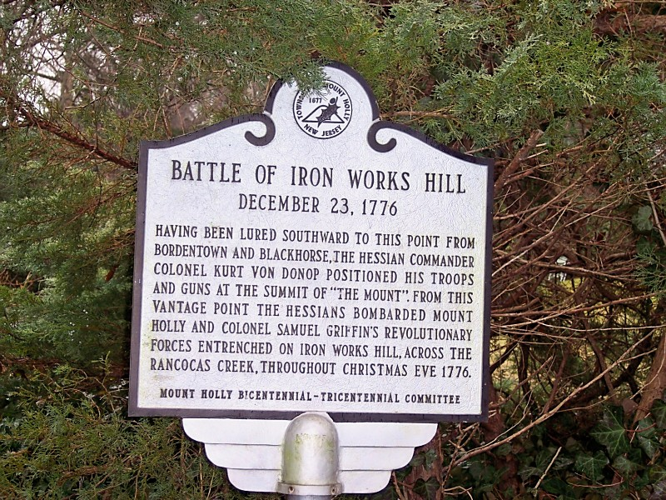
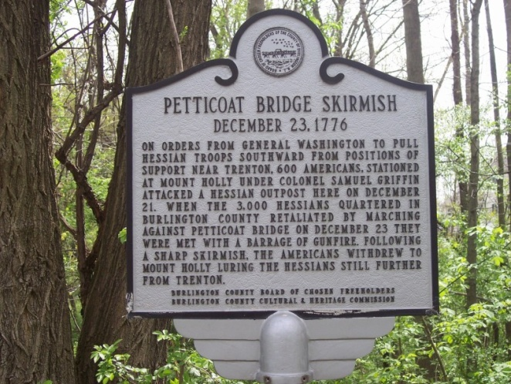


Two signs on left in Mt. Holly; two on the right in Springfield Twp.
71 wds.
92 wds.
69 wds.
65 wds.

Slide 36

70 wds.
Historical Marker erected in Willingboro at corner of JFK Blvd. and Beverly-Rancocas Road by Burlington County Freeholders.

Slide 37




54 wds.
56 wds.
91 wds.
69 wds.

Slide 38










BORDENTOWN

Slide 39

Paul Zimmerman Foundry – Erie Landmark Company
637 Hempfield Hill Road, Columbia, PA 175121
http://www.erielandmark.com/
phone: 800-874-7848 fax: 717-285-9060 email: info@erielandmark.com

Slide 40



Recent local user:
Mt. Holly Historical Society – Larry Tigar, Pres.
609-261-4786 litigarfish@aol.com
Approximate cost of plaque: $280.00
60 words

Slide 41

UPSCALE
CUSTOM DESIGNED
ILLUSTRATIVE
AND
DESCRIPTIVE
HISTORICAL MARKERS

Slide 42


Southampton Township
Contact:
Bob Ritter, President
Southampton Historical Society.
bcritt@verizon.net
609-859-3763
Southampton’s signs were created by:
Alpha 1 Studio, Inc.
3 Linda Lane #A
Southampton, NJ 08088-9174
609-859-2200 – www.signstudio.com
Ray Witthauer, Owner

Slide 43


Slide 44



Slide 45
Smithville Park Industrial Village , Eastampton Township
15 interpretative signs – funded by grant
Design information available from Burlington County Parks Department

Slide 46




Burlington County’s Women’s Heritage Trail Historical Markers
NJ Dept. of Environmental Protection
Historic Preservation Office
Agnes Gilkerson Smith - Eastampton
Alice Paul, Mount Laurel
Elizabeth White, Pemberton Twp.
Clara Barton, Bordentown

Slide 47


TABERNACLE TOWNSHIP

Slide 48




24 wds.
24 wds.
22 wds.
25 wds.
Tabernacle Historical Society, Dorothy Yates, President
609-268-0664
12 Markers

Slide 49



This home, which is now called the Pepper House, was once called the Knight House. It's first owner was Gilbert W. Knight, a GAR veteran of the 23rd Regiment, Burlington County. Knight also acted as the town's blacksmith.
After Knight, Sam and Clara Scott were the owners. The Scotts had an ice cream shop near the house, and at one time, a filling station. The, Arthur "Skimmer" and Clara Pepper became the owners,and were the last inhabitants of this quaint home.
The Tabernacle Historical Society has restored this building to it's original charm, as Knight had built it.
23 wds.

Slide 50






23 wds.
19 wds.
22 wds.
22 wds.
30 wds.

Slide 51
Vendor used by Tabernacle Historical Society
Garden State Highway Products.
1740 E. Oak Rd., Vineland, NJ 08061
General phone # 856-692-7572
Frank Kates (sales) - cell phone: 609-381-2846
e-mail: Frank@GardenStateHwy.com.
Their prices seem somewhat comparable to Deptcor: -
24 x 30 plain rectangular $ 55.00. Special - $75 - $100 each.
post - green - $2.00 per ft. Galvanized $3.00 per ft.

Slide 52



21 wds.

Slide 53


INDIAN MILLS HISTORICAL SOCIETY
SHAMONG TOWNSHIP

Slide 54




29 wds.
20 wds.
23 wds.
Indian Mills Historical Society, Shamong
Joseph Reinhart, President – 609-351-0073
Marie Kulshinsky – 609-760-1544
21 wds.

Slide 55







20 wds.
30 wds.
27 wds.
26 wds.
18 wds.
23 wds.
12 Recent Markers
7 Vintage Markers
27 wds.

Slide 56
From Gail Currier, Corresponding Secretary of the Indian Mills Historical Society:
The company we have used since 1970's is:
GARDEN STATE HIGHWAY PRODUCTS
Vineland, NJ
Tel number: 856-692-1300
Once they had our logo design/color/size/historical info. we were able to fax and or call them when we needed replacements. They have salesmen in the area who can meet with groups about their designs, costs, etc. before ordering.
Our last order for a few replacements ran approx. $130 per. sign. The steel poles were $20 plus $2.00 for hardware.
Costs vary due to logo, size and quantity. We have been very pleased with this company.

Slide 57


Still cemetery sign was $160 due to the fact it was much larger and needed in a hurry.

Slide 58

Inscription. Founded in 1758 by the New Jersey provincial legislature on the Edgepillock or Brotherton tract, now Indian Mills. Under the guidance of the Reverend John Brainerd, a self supporting community was established here. In 1801, the Indians accepted the invitation of the Oneidas in New York to “come and eat out of our dish."
Erected 1958 by The Archeological Society of New Jersey.

Slide 59








Slide 60
THREE
UNIQUE
WORLD WAR I
MILITARY HIGHWAY MARKERS
BURLINGTON COUNTY
DIVISION OF
VETERANS’ AFFAIRS

Slide 61


Rt. 537 - Marne Highway, Mt. Laurel
126 wds.
145 wds.
Rt. 630, Woodlane Rd., Eastampton.
Custodians: Burlington County Office of Veterans’ Affairs

Slide 62

135 wds.
Rt. 630 – Cinnaminson - Delanco

Slide 63

HISTORIC
SCHOOLHOUSE
IDENTIFIERS

Slide 64



Below:
Along McDonald’s Parking Lot
Stokes, Dixontown, and Skeet Roads, Medford
Above:
Off Birmingham Rd. Pemberton Twp.

Slide 65







Medford – behind Union St. Friends’ Meeting
159 Third Avenue,
Roebling

Slide 66
ENGRAVED
BRICKS
AND
PAVERS

Slide 67




Slabs in sidewalks throughout the Village of Marlton identify historic homes.

Slide 68





Slide 69



SMITHVILLE WELCOME CENTER
SMITHVILLE PARK
EASTAMPTON

Slide 70




Engraver:
Frederick Szelc Memorials
Manitoba Trail, Shamong, NJ
609-268-5999
Cell: 609-377-6988
szelcmemorials@gmail.com

Slide 71


Slide 72


18 wds.
211 Mill Street, Mount Holly

Slide 73
Burlington County’s Women’s Heritage Trail Historical Markers
NJ Dept. of Environmental Protection
Historic Preservation Office
Agnes Gilkerson - Eastampton
Alice Paul, Mount Laurel
Elizabeth White, Pemberton Twp.
Clara Barton, Bordentown

Slide 74





MOUNT HOLLY
BORDENTOWN – REVOLUTIONARY WAR
21 wds.
23 wds.
BURLINGTON
24 wds.
22 wds.
21 wds.

Slide 75
EVOLUTION OF THE WORDING OF HISTORICAL MARKER
Concept to be encapsulated - 84 words
Edited version for sign – 40 words +/-
Creation of “blue line” by sign company

Slide 76
Fact to be communicated:
The Burlington County Marl and Transportation Company was incorporated in 1866 by John S. Irick and other Vincentown businessmen. They constructed a railroad spur extending from the Vincentown Train Station terminus of the Burlington County Railroad on North Main St., crossing Mill St. at this spot and continuing along the west bank of the Rancocas Creek on the east side of Red Lion Road for about 1 mile to the Vincentown Marl Pits near Hilliards Bridge Road. The railway operated from 1870 until c.1885.
84 word draft – Goal: maintain concept but reduce to 40 words.
Result: 44-word sign
RR Crossing – 1870-1885
Incorporated in 1866 by John S. Irick and Vincentown investors, the Vincentown Marl Company RR spur crossed here on its one mile route along Rancocas Creek and Red Lion Road from N. Main St. Train Station to Marl Pitts near Hilliards Bridge Rd.

Slide 77


Slide 78





Slide 79


Slide 80


40 wds.
Revolutionary War Marker in Mansfield Township

Slide 81

Latest Edition now on line – Just posted!
September, October, November - 2012
http://co.burlington.nj.us/upload/Parks/Images/CountyBellCurrent.pdf

Slide 82

NEXT ROUNDTABLE MEETING
HISTORIC BORDENTOWN
SATURDAY, NOVEMBER 17, 2010

